Slide 1
Welcome!

Slide 2
How to Set Up a Facebook Page for Your Auxiliary

Slide 3
Megan Zinn-Sanchez
Public Relations & Marketing Coordinator
VFW Auxiliary National Headquarters
mzinn-sanchez@vfwauxiliary.org

Slide 4
A Note from the Presenter:
This presentation is designed to assist you in setting up an Auxiliary Facebook page.
There is much more to Facebook than what is included in this presentation.
If you feel comfortable exploring Facebook Insights, Publishing Tools, Promotions and additional settings, you are welcome to do so!
Let’s Get Started!

Slide 5
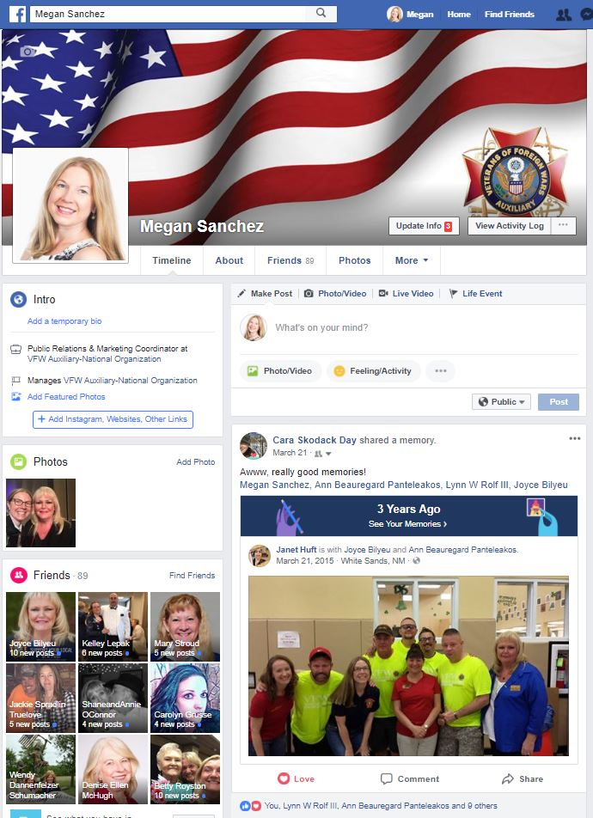
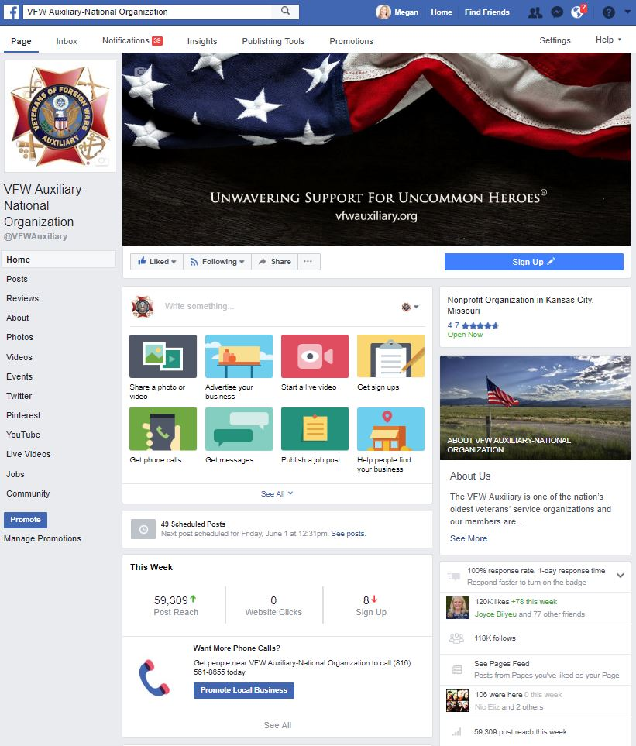
What’s the Difference Between a Personal Profile Page and a Fan Page?
Personal Profile Page
Fan Page

Slide 6
What’s the Difference Between a Personal Profile Page and a Fan Page?
Personal Profile Page
Individuals
Gain Friends
Limited Number of Friends
You Can Request Friends
You are Required to Manually Accept Friends
There is no Reporting
Very few Promotional Opportunities
Fan Page
Companies, Organizations, Brands, Products, Artists, Bands, Public Figures, Causes, etc.
Gain Likes
Unlimited Fans/Likes
You Can’t Request Fans
You Don’t Accept Fans
Reporting!!!
More Promotional Opportunities such as Ads, Promoted Posts, Offers
It’s FREE!!!

Slide 7
What You Need to Create a Facebook Fan Page
A personal Facebook Profile Page.
You will NOT have a separate login for your Fan Page – they will be the same.
A logo or other photo to use as your Auxiliary’s Profile Picture.
Brief description of your Organization.
A horizontal photo that will be used as your Auxiliary’s Cover Photo.

Slide 8
Log in to Facebook using your personal login information.
Go to your Personal Profile Page.
The layout of your Personal Profile Page should look similar to this after you log in to Facebook.

Slide 9
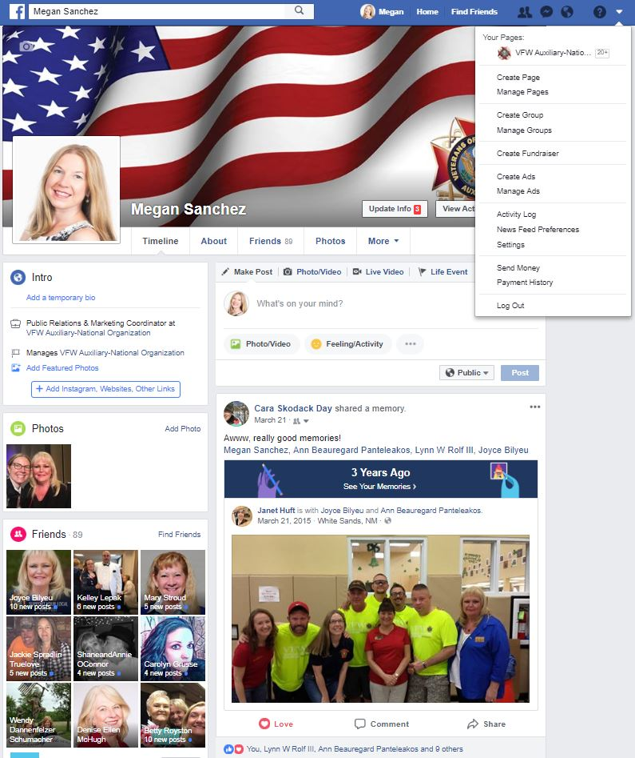
After logging in:
Go to the UPSIDE DOWN TRIANGLE in the upper right-hand corner
Click on “Create Page.”

Slide 10
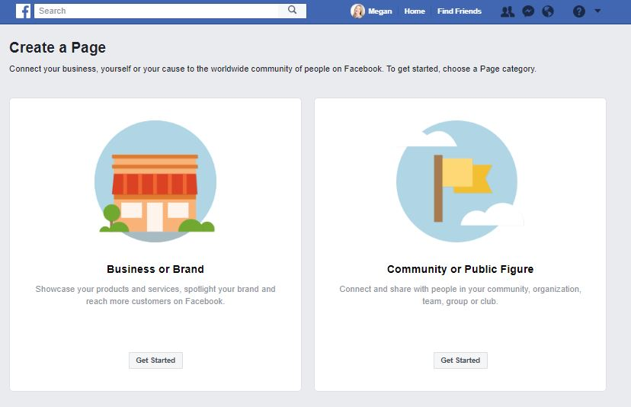
You will be taken to this page that instructs you to “Create a Page.” Click the “Get Started” button in the box on the right
that says “Community or Public Figure.”

Slide 11
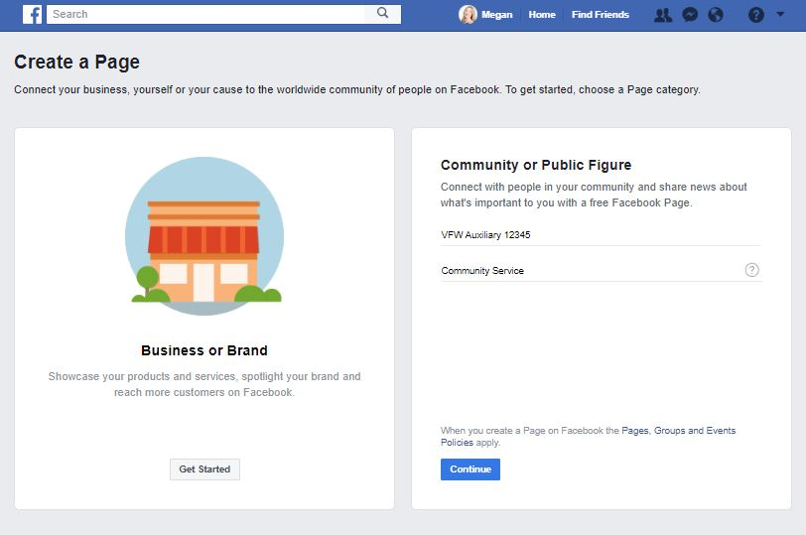
You will be asked to fill in the name of your organization.
Please use VFW Auxiliary and the number of your post. Ex: VFW Auxiliary 12345
For the kind of organization, type “Community Service.”

Slide 12
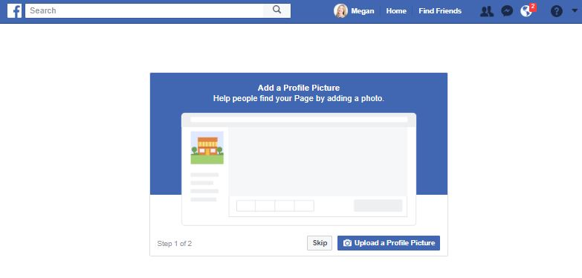
Step 1 of 2: Add a Profile Picture
Select the “Upload a Profile Picture” button to upload a photo.
Tips:
Your Auxiliary’s Profile Picture should be a square image/shape.
Do not use your Auxiliary President’s photo for the Profile Picture.
Suggestions: VFW Auxiliary Emblem, American Flag, Eagle, etc. The VFW Auxiliary Emblem is available in the Emblem Branding Center behind Member Login.

Slide 13
Step 2 of 2: Add a Cover Photo
Select the “Upload a Cover Photo” button to upload a photo.
Tips:
A Cover Photo is a large, horizontal photo that graphically represents your Auxiliary
Suggestions – Flags, Eagles, photos of your Auxiliary volunteering, etc. Download cover photos from the The VFW Auxiliary Emblem Branding Center behind Member Login.

Slide 14
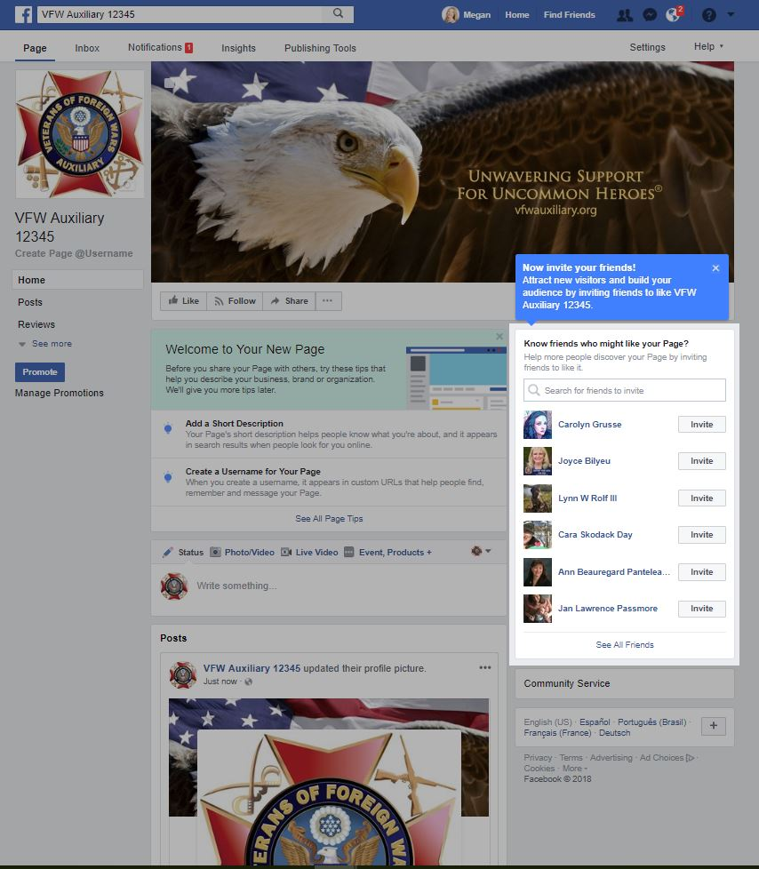
Once you have uploaded a Profile Picture and a Cover Photo, you will be taken to your Auxiliary’s NEW Facebook page!
Your Auxiliary Page will look similar to this once you’ve added a Profile Picture and Cover Photo.
There are so many things you can add and/or update. What should you do?
Start by Creating a Username and Add a Short Description

Slide 15
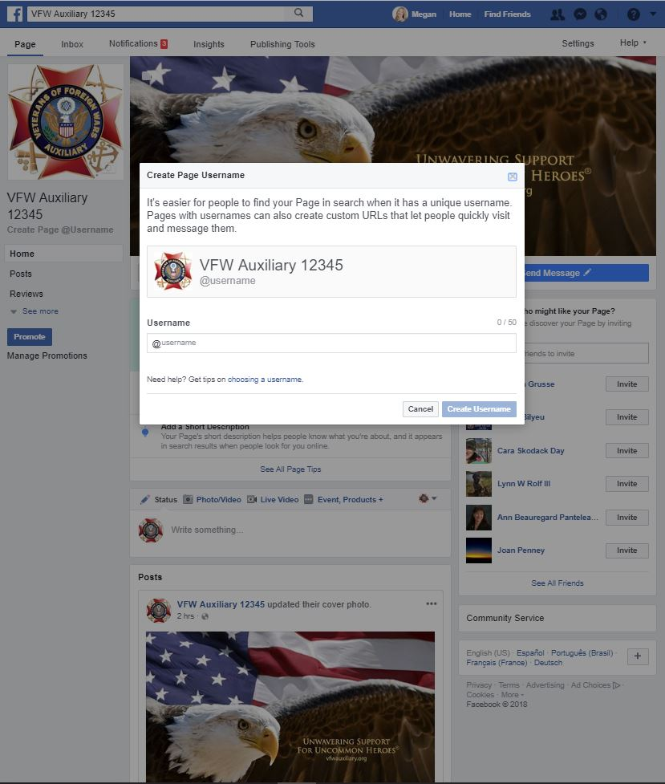
Create Page Username
What is a Page Username?
Your Page Username is the website address for your Auxiliary Facebook Page.
It’s a way for people to find your Auxiliary Page on Facebook
It allows your Auxiliary to be “tagged” by other Pages and people by typing @VFWAuxiliary12345 (or whatever your Auxiliary number is).

Slide 16
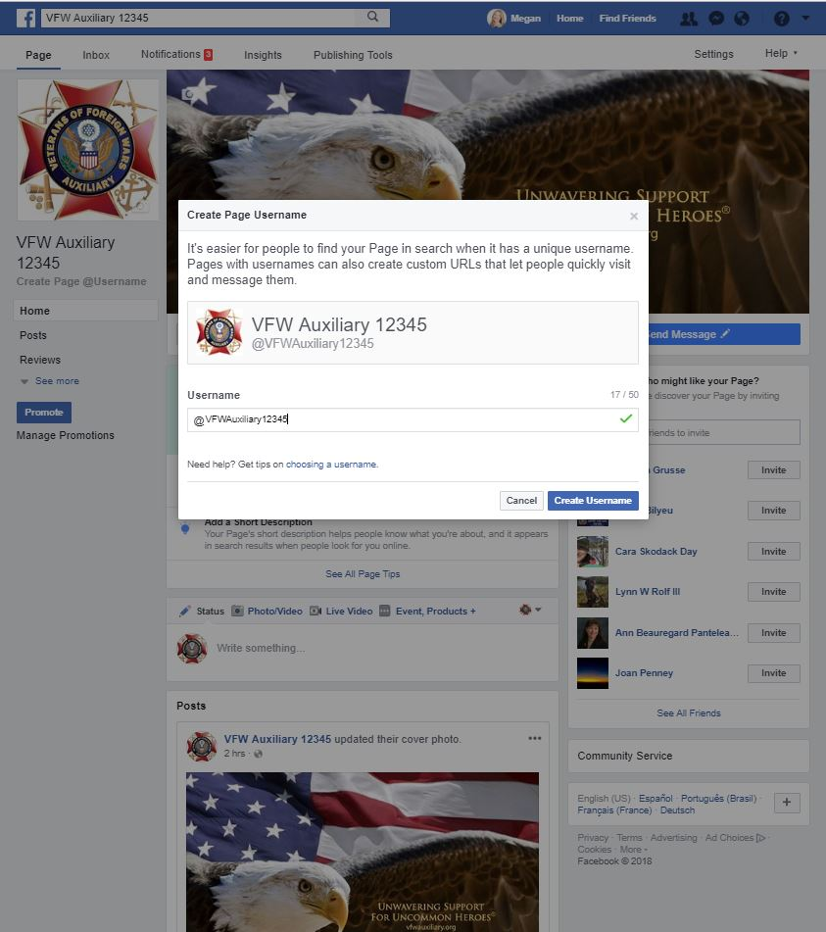
Create Page Username
For your Auxiliary’s Username, please use VFW Auxiliary and the number of your post. Ex: VFW Auxiliary 12345
Once the Username has been entered, (VFWAuxiliary12345 - your Auxiliary number in place of the 12345), click the “Create Username” button.

Slide 17
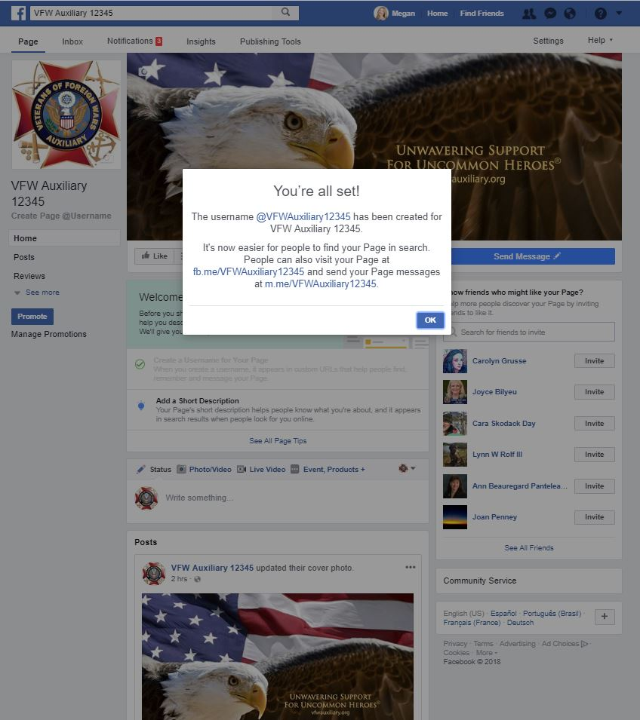
You will be taken to this screen.
Click the “OK” button.

Slide 18
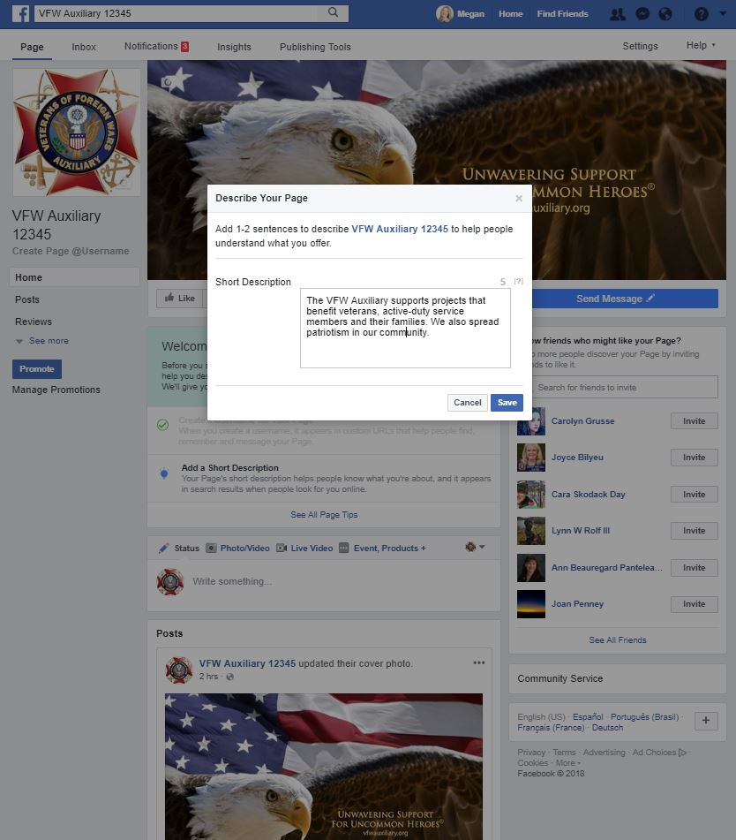
Add a Short Description
What is a Short Description?
It’s the brief introduction to your business or organization that shows up on the "About" section of your Facebook Page.
There’s a limit of 255 characters.
Suggested Short Description:
The VFW Auxiliary supports projects that benefit veterans, active-duty service members and their families. We also spread patriotism in our community.
Once the Short Description has been entered, click the “Save” button.

Slide 19
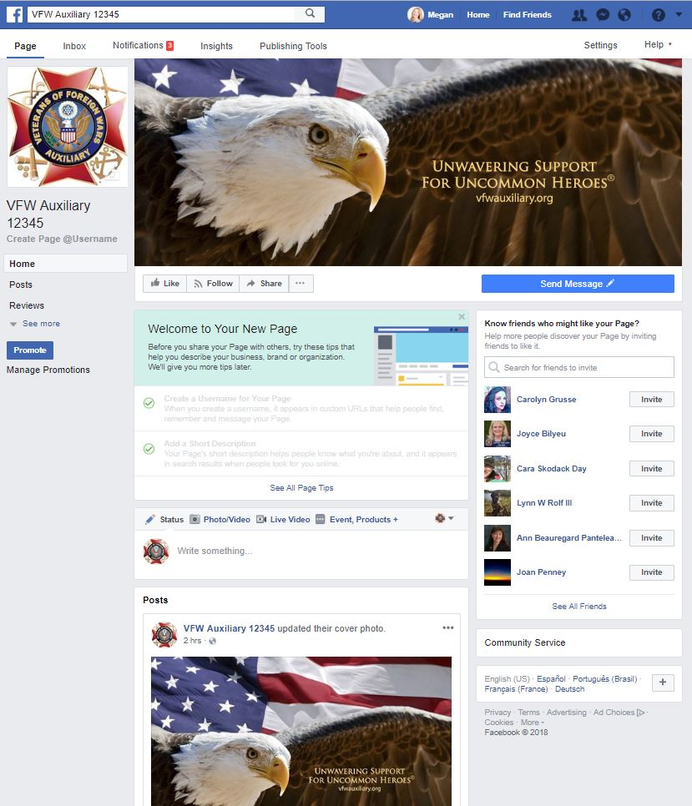
Once the Username and Short Description have been entered, you will be taken back to your Auxiliary Page.
Once you are on this page, select the “Settings” tab.

Slide 20
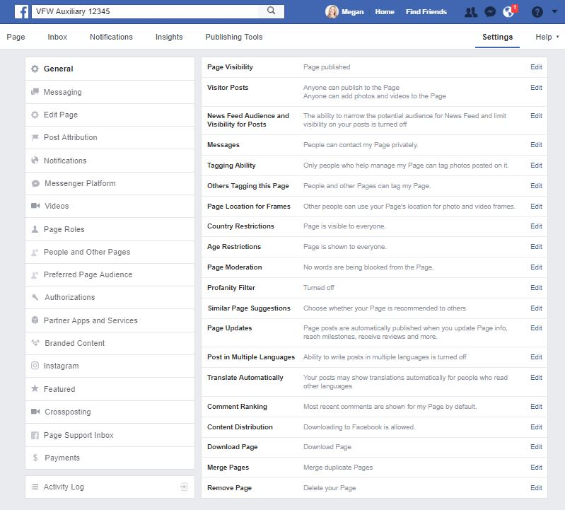
You will be taken to this screen.
Click the “General” tab on the left side of the page.
There are numerous settings you can change in this section, but likely only two that you will WANT to change:
Visitor Posts
Profanity Filter

Slide 21
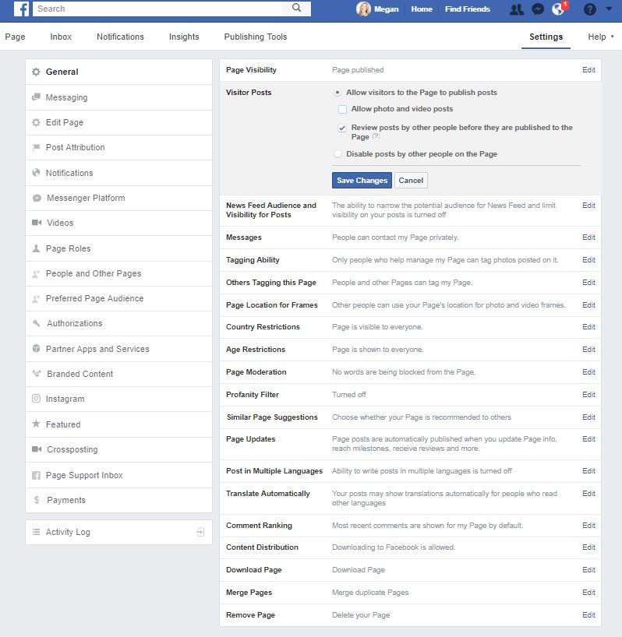
Click “Edit” on the Visitor Posts line and
Allow visitors to the Page to publish posts
Review posts by other people before they are published to the Page.
Click the “Save Changes” button.

Slide 22
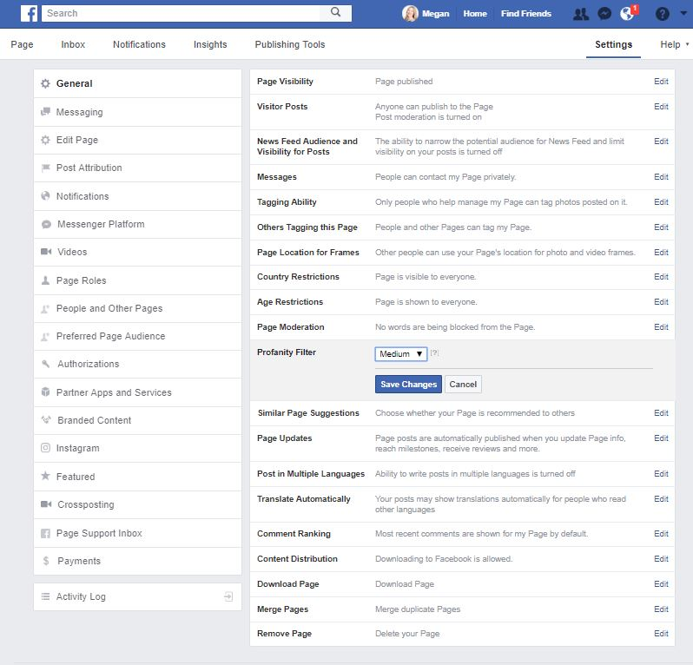
Find the Profanity Filter line and click “Edit.”
Select MEDIUM from the drop-down menu.
Click on the “Save Changes” button.
Click on “Page” to go back to your Auxiliary Page.

Slide 23
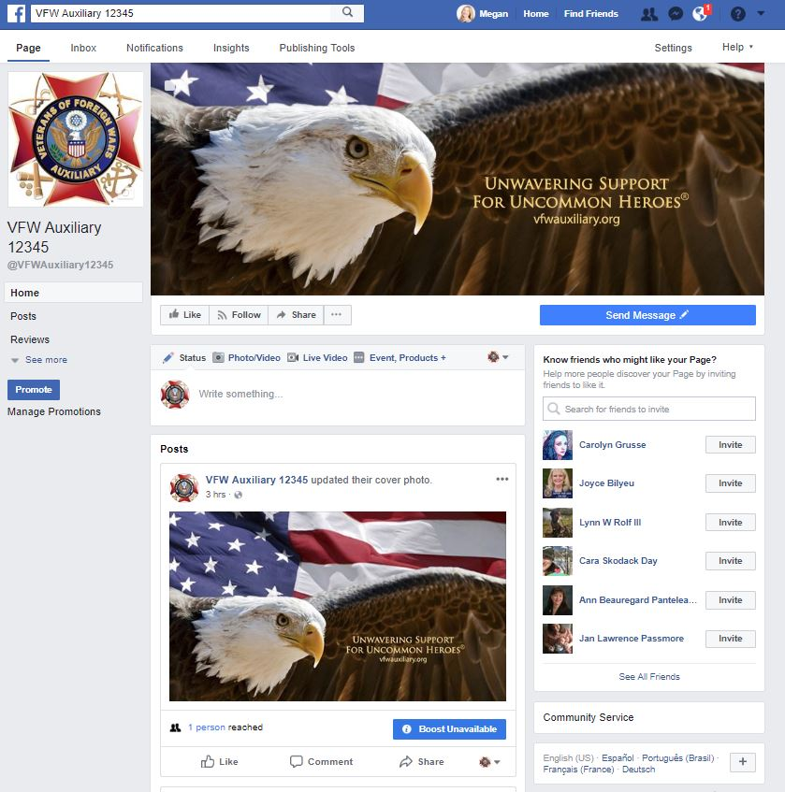
The next step is to enter detailed information about your Auxiliary,
including contact information.
Select the “See More” tab to see the “About” tab.

Slide 24
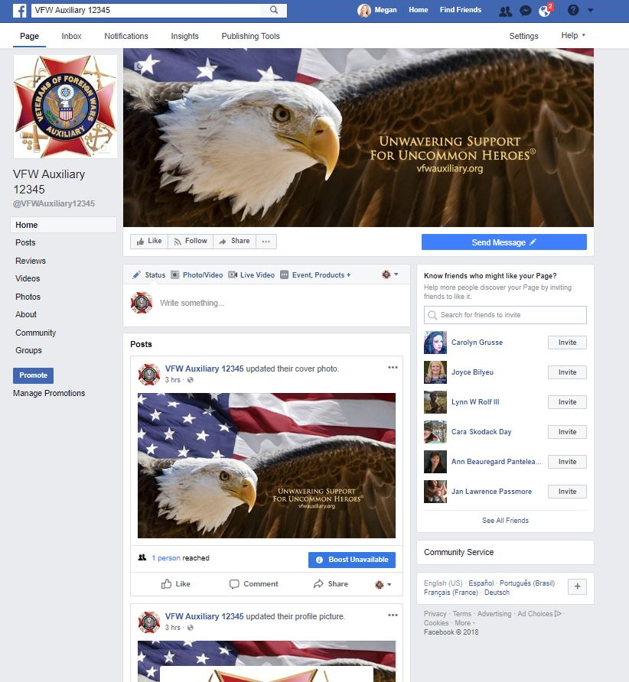
Click the “About” tab.

Slide 25
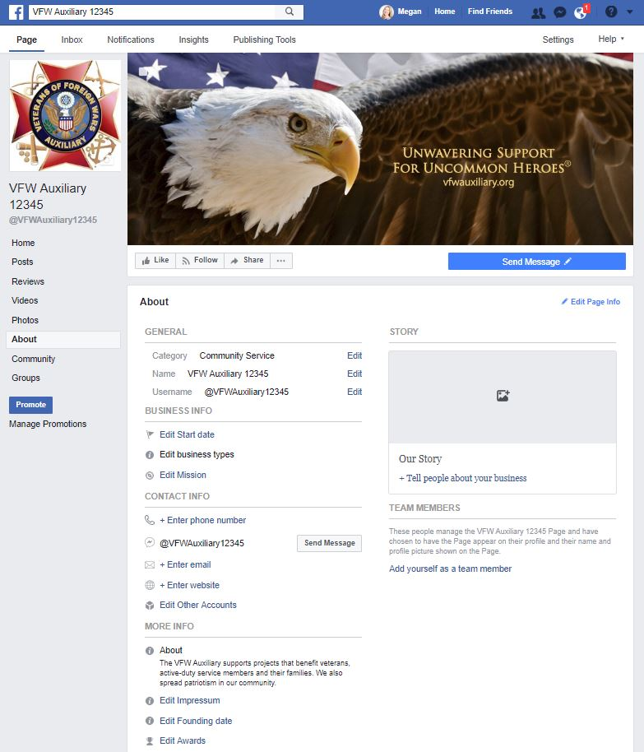
The “About” section will display.
The following have already been created, but your may choose to Edit them if you need to correct something:
Category
Name
Username
Short Description
To edit, click on the link of what you’d like to “Edit,” make your changes and “Save Changes.”

Slide 26
Under “Business Info”:
Enter the year your Auxiliary was instituted.
Leave Edit business types as-is.
Leave Mission as-is.
Under “Contact Info”:
Enter the phone number for your Post/Auxiliary. If your Post/Auxiliary does not have a phone number, leave this blank.
Enter the email address for your Auxiliary. If your Auxiliary does not have an email address, leave this blank.
Enter the website for your Post/Auxiliary. If your Post/Auxiliary does not have a website, list the National VFW Auxiliary website: https://www.vfwauxiliary.org.
Under “More Info”:
Leave Impressum as-is.
Feel free to add awards or other information.

Slide 27
Under “Our Story”:
Add a patriotic photo or a photo of your Auxiliary members.
Write information about your Auxiliary or use the following:
The VFW Auxiliary is one of the nation’s oldest veterans’ service organizations and our members are the relatives of those who have served in overseas combat. We have nearly a half million members nationwide who volunteer millions of hours and fundraise millions of dollars for charitable projects that benefit veterans, military service personnel, and their families. Through our National Programs, we assist the VFW pass or block legislation that impacts veterans and their families, provide nearly a million volunteer hours in the VA medical system, conduct patriotic programs with thousands of students and offer hundreds of thousands of dollars in scholarships for our nation’s youth. With nearly 4,000 Auxiliaries, there is likely one in your area working to improve the lives of America’s uncommon heroes.

Slide 28
Once all changes have been made, click the “Home” tab.

Slide 29
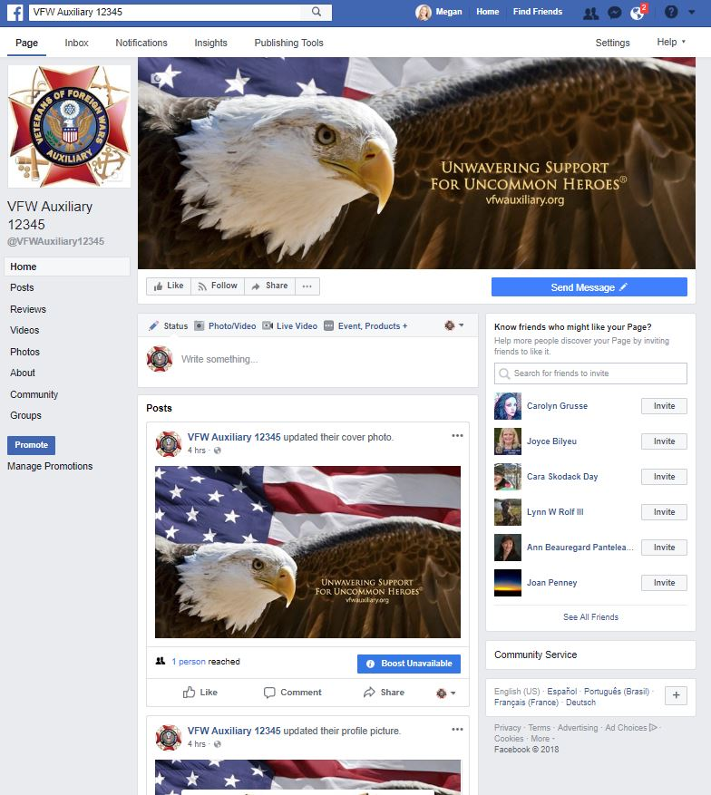
Next you will choose how people can contact your Auxiliary.
Click the “Send Message” button.

Slide 30
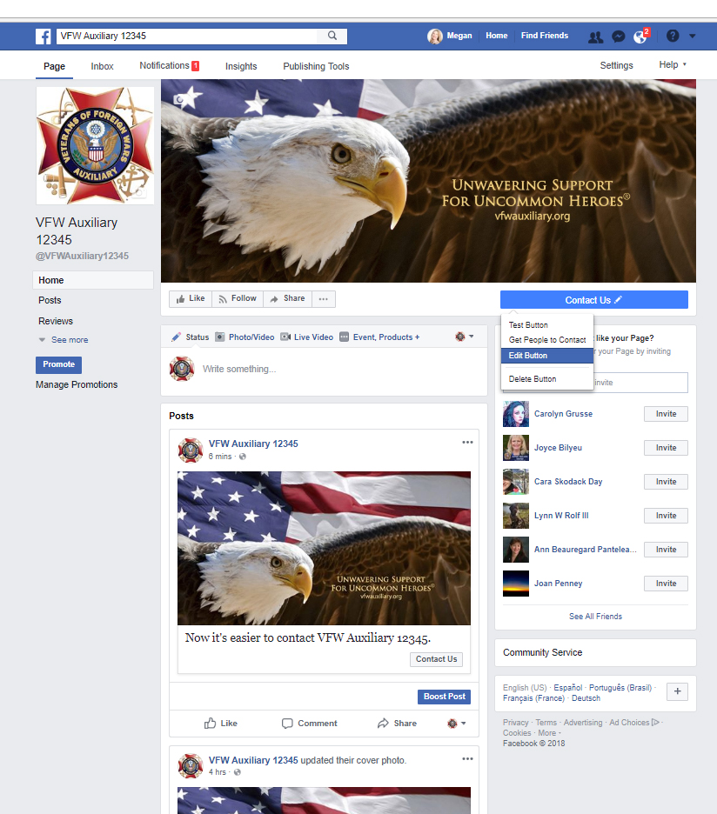
Select “Edit Button.”

Slide 31
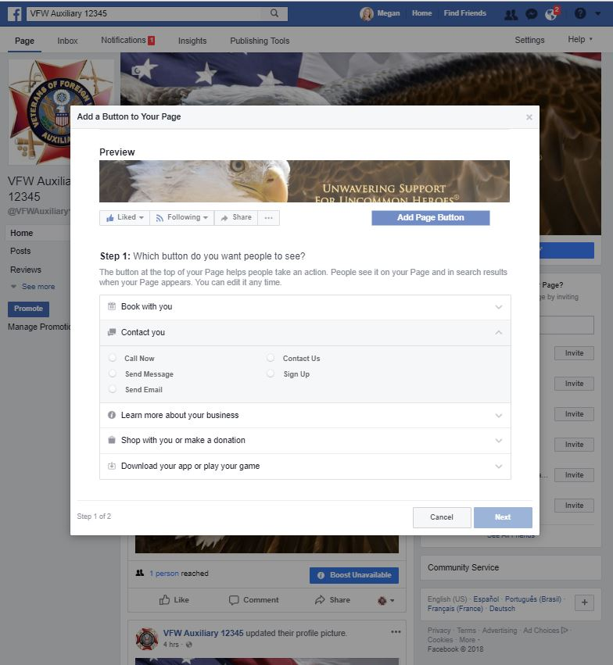
Select “Contact you”
Choose how you would like people to contact your Auxiliary:
Call Now (Phone)
Send Message (Facebook message)
Send Email (Email)
Contact Us (Website Link)
Sign Up (Website Link)
Once you have selected the method of how your Auxiliary will be contacted, click the “Next” button.
Fill in the information and click “Finish.”

Slide 32
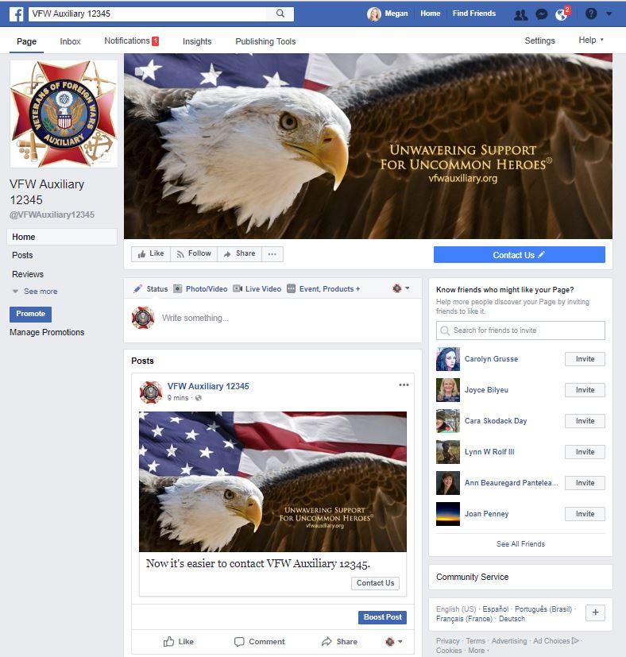
Your Contact button is live!

Slide 33
Now that your Auxiliary Page is set up, be sure to “Like” it and “Follow” it to see the updates in your News Feed!

Slide 34
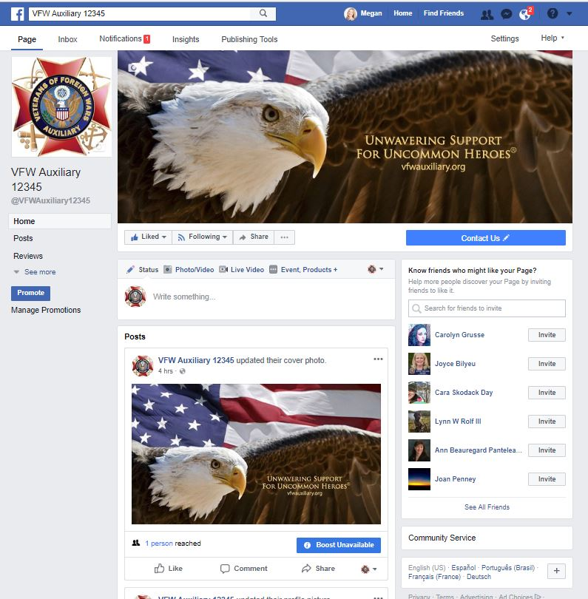
You have successfully created your Auxiliary Facebook Page!
Great job!!!
Tip: Be sure and invite your Facebook friends to “Like” your Auxiliary Page!

Slide 35
Questions?
Contact Megan Zinn-Sanchez
Public Relations & Marketing Coordinator
VFW Auxiliary National Headquarters
mzinn-sanchez@vfwauxiliary.org

